Slide 1
World History Lessons
Week 3 (April 27-May 1)

Slide 2
WH Ep. 36 – Archdukes, Cynicism, and World War I
World War I – The War to Change All Wars
Causes
Assassination of Archduke Franz Ferdinand of Austria-Hungary in Sarajevo
Alliances, Mobilization, Imperialism, Economic Rivalries, Ideologies
Cultural belief that war is good (Us vs. Them)
Soldiers from all over the world (including colonies) → calls for nationalism

Slide 3
WH Ep. 36 – Archdukes, Cynicism, and World War I
Destruction of World War I
15 million dead, 20 million wounded, many more civilians killed
Disease was significant killer (influenza epidemic at end of war)
New Technology – machine guns, barbed wire, tanks, airplanes, poison gas
Western Front – trench warfare stalemate
Soldiers testaments about conditions in the war

Slide 4
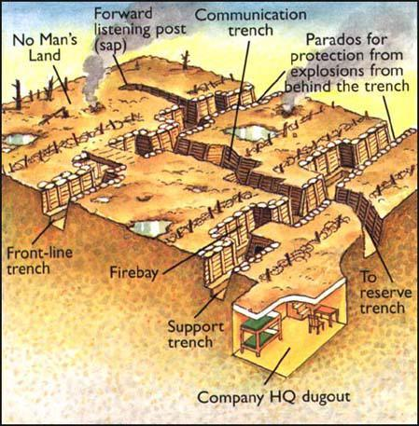

Slide 5
WH Ep. 36 – Archdukes, Cynicism, and World War I
Results of the War
Blame put on Germany, destroying them
Russia devastated and plagued by two civil wars in one year (early departure from war)
U.S. – creditor nation, geopolitical influence
End of Ottoman Empire
Sense of disappointment, pointlessness, and cynicism – Lost Generation
“War might be necessary but will never be glorious.”

Slide 6
EH Ep. 32 – The Roads to World War I
Old Causes of the War – alliance system, arms build up, secret treaties, nationalism, imperialism
Complex Roads to War (social and cultural change)
Changing family structures
Paradigm shifts in science
Changing of traditional gender roles
Achievement of the vote
Economic advances

Slide 7
EH Ep. 32 – The Roads to World War I
Pre-war Europe as a battlefield already
Growing world conflicts
Ireland vs. British rule
Colonial resistance around the world
French in Indochina
Germans in Africa
Dutch in South Africa against Boers
Boxer Rebellion in China
Southeast Asia boycott of British

Slide 8
EH Ep. 32 – The Roads to World War I
Growing tensions and conflicts
Kaiser William II (Germany) – followed press coverage of himself, erratic behavior, emotional reactions
Russian revolt against tsar, Russo-Japanese War
Balkans organized against Ottomans and Hapsburgs
Turkish nationalists & Young Turks strengthening
Austria-Hungary took Bosnia (angering Serbia)
First and Second Balkan Wars – Serbia gaining significant land/status (worried Austria-Hungary and Germany

Slide 9
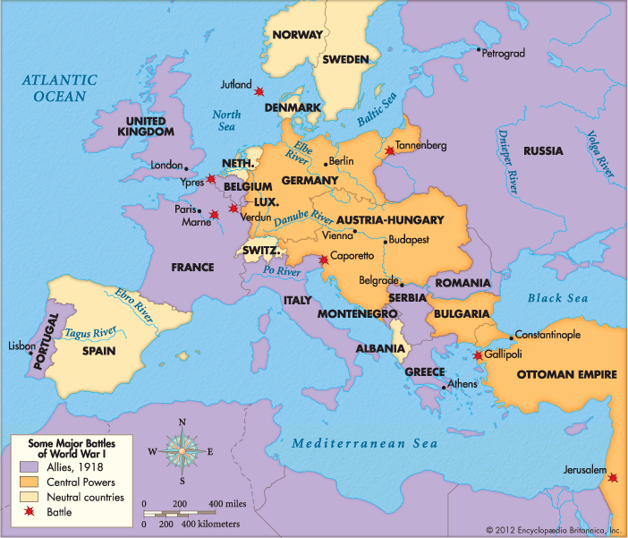

Slide 10
EH Ep. 33 – World War I Battlefields
Quick mobilization (Austria-Hungary, Germany, Russia, France) – railroads, automobiles
Germany’s Schlieffen Plan (attack France through Belgium, Britain’s surprise entry into war)
Eastern Front (constant movement) vs. Western Front (trench warfare, no mobility)
Endless supply of soldiers (colonial soldiers in front)
Italy and Ottoman Empire join war
Christmas Truce of 1914 – both sides socialized in No Man’s Land

Slide 11
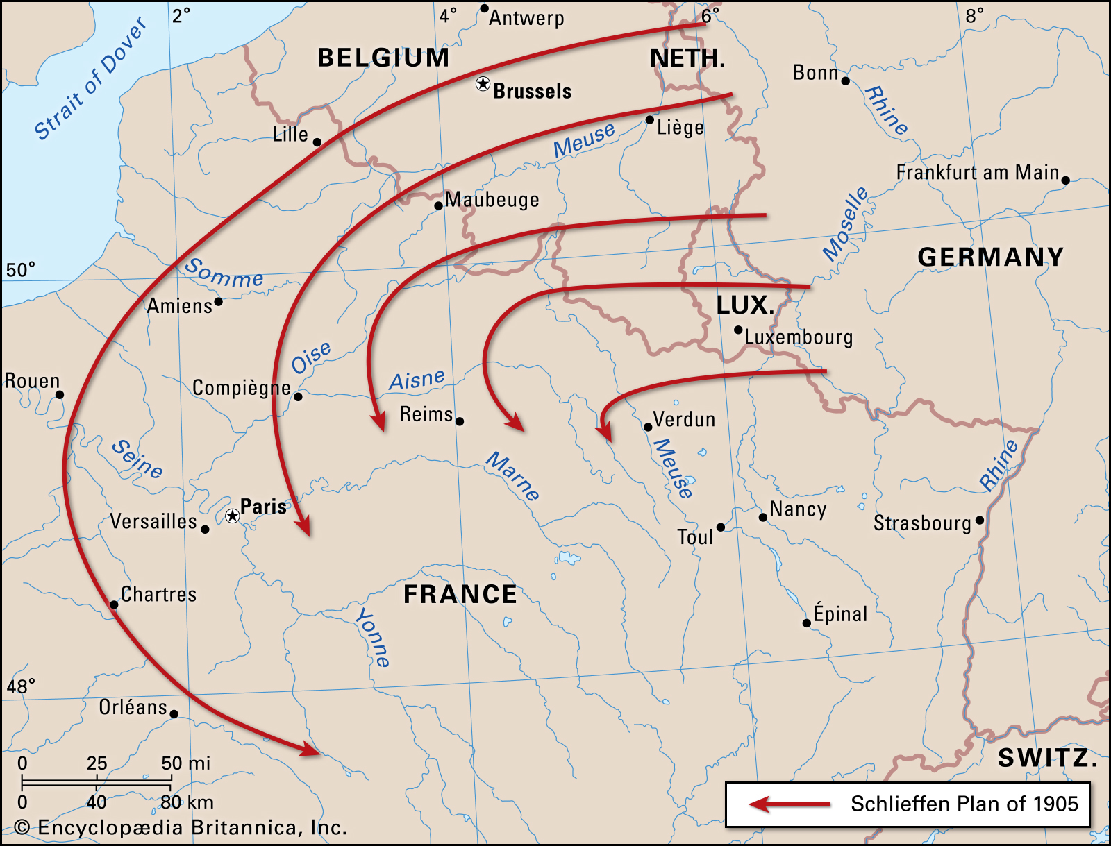
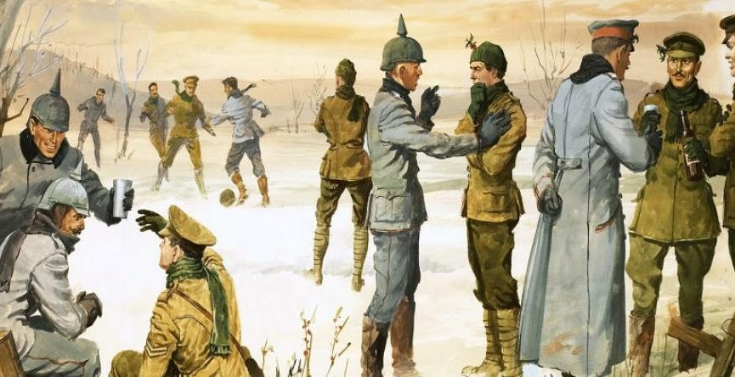

Slide 12
EH Ep. 33 – World War I Battlefields
New Technology – mustard/poison gas, airplanes, massive firepower with significant damage
Romanticizing war → war is hell
Ethnic Cleansing – Jewish, Polish, Muslims, Armenians all targeted
1915 Armenian Genocide by Ottoman Turks (600,000-1 million dead)
Naval stalemate with battleships and submarines – German submarine attacks helped bring U.S. into the war
War weariness → civilian uprisings

Slide 13
EH Ep. 33 – World War I Battlefields
Women’s peace plan rejected
Heads of state resistant to ending war but eventually moved in that direction
Allies push Central Powers to Germany
President Woodrow Wilson’s Fourteen Points (seen as rational settlement)
November 11th – World War I Armistice (cease-fire) → Veterans Day
Far greater number of deaths than initially calculated (40 million)

Slide 14
EH Ep. 34 – WWI’s Civilians, the Homefront, and an Uneasy Peace
Total war – mobilization on the battlefront and homefront
Use of factories, farms, rationing, railroad schedule, censored speech, shift entire life to wartime effort
Positives – lessening of political and cultural/ethnic divisions (somewhat), job opportunities for women
Negatives – difficult for child care, censorship laws, gender tensions increasing, widespread inflation, food declined, anti-Semitism, rising wealth (no tax on war profits)

Slide 15
EH Ep. 34 – WWI’s Civilians, the Homefront, and an Uneasy Peace
Scorched-earth policy (Russia, Germany, Austria-Hungary)
Understanding of the world expanded (still and motion photography)
Significant number of refugees across Europe (care needed for people)
November 11th armistice failed with uprisings spreading
Spanish flu (influenza) → around 100 million deaths

Slide 17
EH Ep. 34 – WWI’s Civilians, the Homefront, and an Uneasy Peace
1919 Paris Peace Conference to determine lasting peace
Excluded Germany, Austria-Hungary, Ottomans, Russia (civil war)
Peace of Paris
Dismantled German, Ottoman, Austro-Hungarian Empires
Treaty of Versailles took German colonies, imposed huge penalty, restricted German military, imposed War Guilt Cause
League of Nations founded (U.S. never joined)
Britain and France expanded territory with mandates

Slide 18
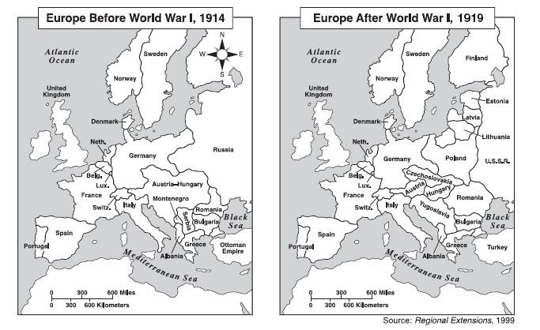

Slide 19
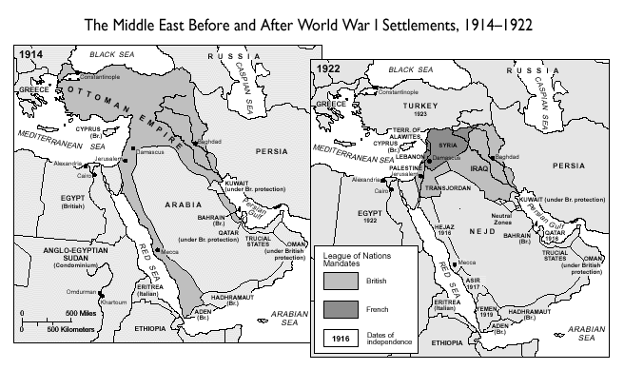

Slide 20
Questions to Consider
Prepare your thoughts on these questions in preparation for the video class meeting on Friday
What do you think is the biggest reason World War I occurred (other than the assassination of Archduke Franz Ferdinand?
What is the biggest lesson to learn from World War I?
What was the most surprising fact about World War I?

