Slide 1
Economics Notes (Week One)
Economics – Mr. Bardelline

Slide 2
Episode 2 – Specialization and Trade
Specialization and trade make the world better off
U.S. produces 40% of the world’s airplanes but 2% of the world’s shoes

Slide 3
Episode 2 – Specialization and Trade
Adam Smith (first modern economist): self-sufficiency is inefficiency and inefficiency leads to poverty
Specialization examples – pizza store, cell phones

Slide 4
Episode 2 – Specialization and Trade
Individuals and countries should specialize in producing things in which they have a comparative advantage and then trade with other countries that specialize in something else. This trade is mutually beneficial.

Slide 5
Episode 2 – Specialization and Trade
U.S. Major Exports: processes petroleum oils, crude oil, cars, auto parts
U.S. Major Imports: machinery (computers), electronic machinery, vehicles

Slide 6
Episode 2 – Specialization and Trade
International trade concerns over child labor, pollution, dangerous working conditions
Cuba, Venezuela, Zimbabwe, Iran – “voluntarily or involuntarily cut off from the world”

Slide 7
Episode 3 – Economic Systems and Macroeconomics
Economic System is reflected by 1) What will we produce?, 2) How will we produce it?, and 3) Who gets it?
Free Market/Capitalism, Command/Centrally Planned, Socialist, Communist

Slide 8
Episode 3 – Economic Systems and Macroeconomics
Karl Marx – The theory of communism may be summed up in the single sentence: abolition of private property
Communism in China, Cuba, Soviet Union (but not really); command argument only in North Korea and nostalgic Cubans and Russians (?)

Slide 9
Episode 3 – Economic Systems and Macroeconomics
Adam Smith – It is not from the benevolence of the butcher, the brewer, or the baker that we expect our dinner, but from their regard to their own interest.
If there’s no demand for a product, resources won’t be wasted on it

Slide 10
Episode 3 – Economic Systems and Macroeconomics
Changes in the demand for different products over time – cars, computers, phones, music, appliances, clothing, food, etc.

Slide 11
Episode 3 – Economic Systems and Macroeconomics
Modern economies are neither completely free nor planned. There’s a spectrum of government involvement.

Slide 12
Episode 4 – Supply and Demand
How supply and demand interact with each other
With markets based on voluntary exchange, the price is there for a reason
If you don’t like the policies of a place, don’t shop there

Slide 13
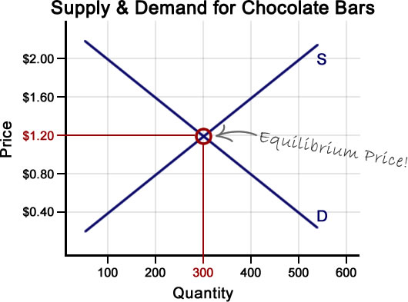
Episode 4 – Supply and Demand
Law of Demand and Law of Supply, Demand Curve and Supply Curve, Equilibrium Price, Surplus and Shortage

Slide 14
Episode 4 – Supply and Demand
Businesses, and in particular large corporations, are often villainized as greedy, heartless institutions that take advantage of consumers, but if markets are transparent and buyers are free to choose, then businesses will have a hard time taking advantage of people.

Slide 15
Episode 4 – Supply and Demand
Corporate Transparency/Freedom to Choose – conglomerates, monopolies, corporate consolidation, variety of products vs. differences in products

Slide 17
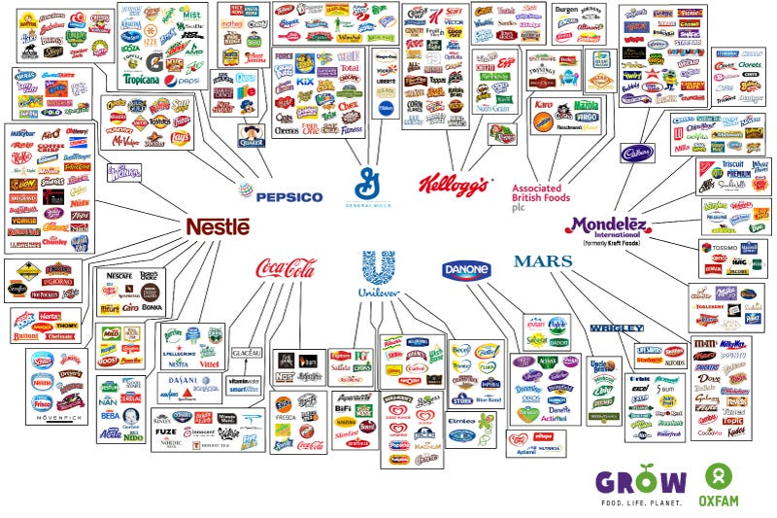

Slide 18
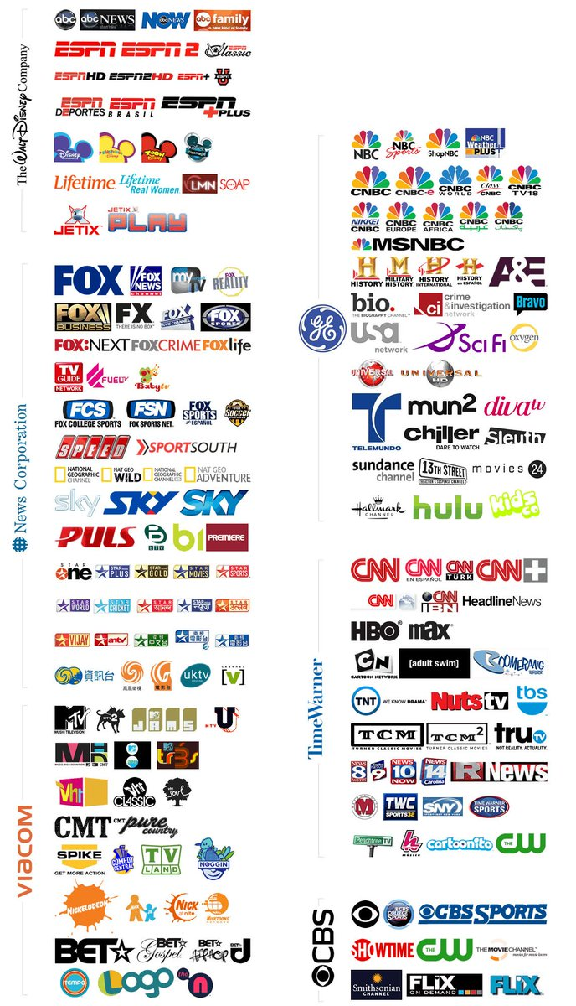

Slide 19
Episode 4 – Supply and Demand
Payment for organs is likely to take unfair advantage of the poorest and most vulnerable groups, undermines altruistic donations, and leads to profiteering and human trafficking.

Slide 20
Episode 4 – Supply and Demand
Debate over concepts such as incentives, subsidies, bailouts, moral obligations, societal obligations

