Slide 1
Economics Lessons
Week 5 (May 11-15)

Slide 2
Ep. 16 – Globalization & Trade & Poverty
United Nations goals for 2015
Reduce childhood poverty
Ensure gender equality
Combat major diseases
Eradicate extreme poverty and hunger
Extreme poverty: severe deprivation of basic human needs, including food, safe drinking water, sanitation facilities, health, shelter, education, & Information
Extreme poverty has fallen thanks to better access to education, humanitarian aid, and globalization/trade

Slide 3
Ep. 16 – Globalization & Trade & Poverty
Economist Jeffrey Sachs – mobile phones are the “single most transformative technology” when it comes to the developing world. Why?
Leapfrogging – skipping to better technology
Development of globalization
Competition for cheapest ways to make products
Corporations/businesses and consumers win
High-wage workers lose (jobs moved)
Are low-wage workers winners or losers?

Slide 4
Ep. 16 – Globalization & Trade & Poverty
Critiques of globalization
Exploitation and oppression
Different rules in developing vs. developed nations
Lack of sustainability
Awareness as first step to improvement
Pushing for rise in competition as developing nations grow will increase wages
Microcredit – loans to disadvantaged to encourage growth
Enabling people to participate in the economy on their own terms

Slide 5
Ep. 16 – Globalization & Trade & Poverty
WRAP-UP THOUGHTS (from video)
“In my experience, poor people are the world’s greatest entrepreneurs. Every day, they must innovate in order to survive. They remain poor because they do not have the opportunities to turn their creativity into sustainable income.”
The challenge of progress being hard to stomach
Some people getting out of poverty in the developing world with jobs, wages, and working conditions that are tough for many others to imagine

Slide 6
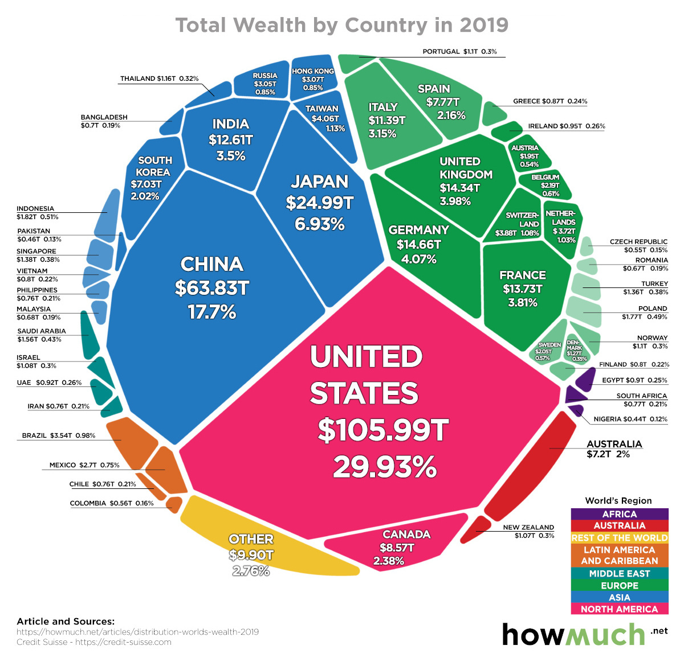
Ep. 17 – Income & Wealth Inequality
Wealth Inequality represents differences in savings, pensions, real estate
Income inequality represents difference in new earnings being added
“at first, countries’ incomes were all bunched together, but with the industrial revolution the differences exploded…it pushed some countries forward onto the path to higher incomes while others stayed where they had been for millennia.”

Slide 7
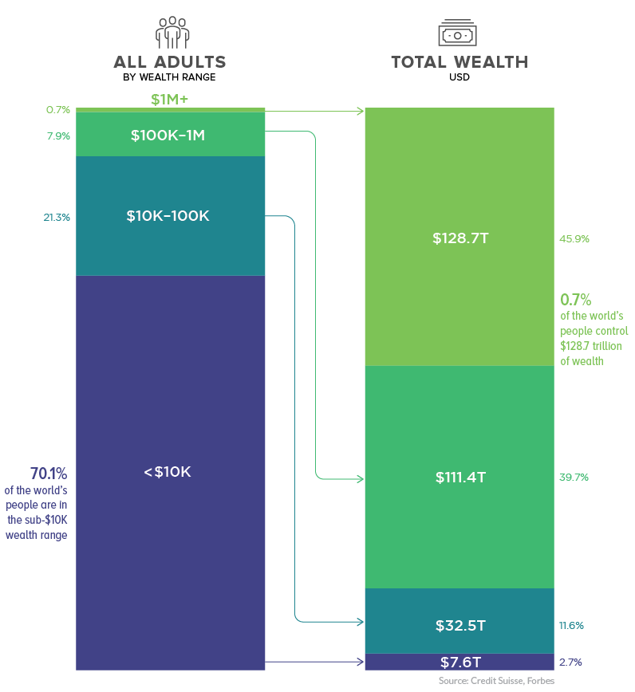
Ep. 17 – Income & Wealth Inequality
Gap between the richest and poorest countries getting larger
“The triumph of globalization and market capitalism has improved living standards for billions while concentrating billions among the few”
The very poor are doing slightly better while the very rich have become much richer.

Slide 8
Ep. 17 – Income & Wealth Inequality
Inequality rising due to skill-biased technological change, reduced influence of unions, tax policies benefitting the rich, pay differential between ceo’s and workers, race & gender inequality
Doubled the percentage of those with a college degree living in poverty and nearly 4x the percentage of those with a high school degree living in poverty
Trend of the top 1/5 earning greater percentage of income with the bottom 4/5 overall earning smaller percentage of income

Slide 9
Ep. 17 – Income & Wealth Inequality
WRAP-UP THOUGHTS (from video)
Greater income inequality can be associated with violence, drug abuse, incarceration rate with the RICH having a greater say in politics, power, and public policy
What to do about the inequality?
Education, affordable child care, social safety net, increase in minimum wage
Changes to the tax rates, changes to regulation, changes to bureaucracy

Slide 10
Ep. 19 – Markets, Efficiency, & Price Signals
Productive efficiency: products made at the lowest cost
Allocative efficiency: production represents consumer preferences
General movement away from central planning (seen as inefficient)
“Central planners are less likely to be allocatively efficient because they have a harder time getting feedback about what people want”
Market research and price signals give producers info in a free market and help to use resources efficiently – incentives, competition are key pieces

Slide 11
Ep. 19 – Markets, Efficiency, & Price Signals
Markets aren’t perfect and can fail to meet needs
FDA regulations, national defense, public education
PRICE GOUGING: raising prices on essential items
Debate over anti-price gouging laws
Long-run effect vs. short-term benefit
Role of private business vs. government in times of crisis – think of current pandemic

Slide 12
Ep. 19 – Markets, Efficiency, & Price Signals
Below-cost pricing/predatory pricing
Keeping prices low even at a loss in order to force out competitors
Eventual need to raise prices and no guarantee it’s worth it
Corporate greed, inequality, and disregard for the environment can lead to question of whether markets are evil
Debate over coexistence of capitalism and altruism
Capitalism as crowdfunding

Slide 13
Ep. 19 – Markets, Efficiency, & Price Signals
Wrap-Up Thoughts (from video)
If you don’t like the policies of a place, don’t buy from them
It’s on us to seek out companies that do better
There are shared societal goals and decisions made on how to spend our time, energy, and money
Paying a higher price based on conscience isn’t always an option

Slide 14
Questions to consider
Prepare your answers for these questions in preparation for Friday’s class meeting
What issues are important to focus on when addressing global poverty?
What are some ways to address income inequality in the U.S.?
Should there be rules on businesses like those against price-gouging or against predatory pricing?

