Slide 1
Economics Lessons
Week 4 (May 4 – 8)

Slide 2
Ep. 13 – Recession, Hyperinflation, & Stagflation
1920’s Weimar Germany and 2007 Zimbabwe – hyperinflation from government printing money
Vastly higher prices and dollar losing most of its value
HYPERINFLATION: country experiences massive rise in monthly inflation rate
Erodes wealth and “Extreme inflation also forces people to spend as quickly as possible rather than save or lend, so there is no money available to fund new businesses. And all that uncertainty limits foreign investment and trade.”

Slide 3
Ep. 13 – Recession, Hyperinflation, & Stagflation
Once output is maximized – the more money you print, the more inflation you get
Constantly rising prices lead people to quickly buy items assuming the prices will rise → prices rise more and more people buy thinking prices will still rise (cycle)

Slide 4
Ep. 13 – Recession, Hyperinflation, & Stagflation
DEPRESSION: when GDP falls for a long period of time
More workers than jobs, more output than customers
Falling prices lead people to wait, assuming prices will fall → prices continue falling and more people wait for lower prices (cycle)

Slide 5
Ep. 13 – Recession, Hyperinflation, & Stagflation
STAGFLATION: Output slows/stops (stagnates) at the same time prices rise (inflation)
1970’s rise in oil prices → money supply boosted and interest rates lowered but output dropped due to supply shocks
Paul Volcker cut the money supply and raised interest rates → low output and high unemployment but prices were lowered

Slide 6
Ep. 13 – Recession, Hyperinflation, & Stagflation
WRAP-UP THOUGHTS (from video)
The entire economy is made up of collective decisions of individuals
Economic policies need to focus on expectations and to ensure confidence

Slide 7
Ep. 14 – Economic Schools of Thought
Thomas Malthus – population growth would outpace food production
Social Darwinism – money to the poor is immoral
Economic theories reflect different attitudes on human nature
“Economic theories are constantly being proven, disproven, and revised. The problem is, when these theories are wrong, millions of people can be adversely affected.”

Slide 8
Ep. 14 – Economic Schools of Thought
Adam Smith (The Wealth of Nations) – production, markets, self-interest serves common good, free trade
David Ricardo – comparative advantage in trade
Smith/Ricardo led to creation of private property and free markets
Karl Marx and Friedrich Engels (The Communist Manifesto) – conflict between workers and owners leading to stateless and classless society

Slide 9
Ep. 14 – Economic Schools of Thought
Classical Economics – Alfred Marshall – supply and demand, marginal utility
Keynesian Economics – John Maynard Keynes – macroeconomics, government can use monetary and fiscal policy to help markets that can’t self-correct quickly

Slide 10
Ep. 14 – Economic Schools of Thought
SOCIALISM: means of producing and distributing goods if owned collectively or by a centralized government
Some have private property and markets mixed with government ownership and big public programs
Friedrich Hayek/Ludwig Von Mises (Austrian School) and Milton Friedman (Chicago School) – heavy state involvement hasn’t produced intended results, regulation is a problem, economy is too complex

Slide 11
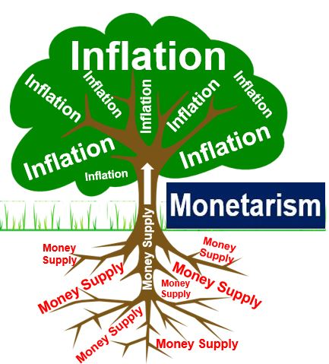
Ep. 14 – Economic Schools of Thought
MONETARISM – focus on price stability, increase money supply steadily and predictably for steady growth
SUPPLY-SIDE (TRICKLE-DOWN) ECONOMICS: emphasize deregulation and cutting taxes (especially corporate); allows money to flow from the top to the bottom of the population

Slide 12
Ep. 14 – Economic Schools of Thought
WRAP-UP THOUGHTS (from video)
Various schools of thought ultimately produce policies that affect millions of people (think of the 2008 financial crisis)
“Ideas shape the course of history”
We don’t know what kind of changes humans will face.

Slide 13
EP. 15 – Imports, Exports, & Exchange Rates
U.S. is the world’s largest importer and the world’s 2nd largest exporter
Canada/Mexico are the largest trading partner for the U.S.
Net Exports (difference between exports and imports) results in trade surplus or trade deficit

Slide 14
EP. 15 – Imports, Exports, & Exchange Rates
Comparative Advantage policies bring in products at a more affordable cost but those savings can come with problems surrounding wages, working conditions, and environmental issues
International trade does reshuffle jobs but the quality of those jobs can be very different around the world

Slide 15
EP. 15 – Imports, Exports, & Exchange Rates
North American Free Trade Agreement (NAFTA) – U.S., Canada, Mexico
Trade barriers dropped led to 1990’s economic boom and lower prices but also increased trade deficits and decreased manufacturing jobs (U.S.)
Protectionism – high tariffs on imports
World Trade Organization (WTO) – sets specific rules for trade and settling disputes but accused of protecting the rich and not addressing environmental or worker issues

Slide 16
EP. 15 – Imports, Exports, & Exchange Rates
Exchange Rates represent the worth of currency
Appreciation in currency (increase in value) → imports are cheaper (increase) while exports are more expensive (decrease)
Depreciation in currency (decrease in value) → imports are more expensive (decrease) while exports are cheaper (increase)

Slide 17
EP. 15 – Imports, Exports, & Exchange Rates
Balance of Payments (all international transactions)
Current Account: sale/purchase of goods and services, donations, foreign aid, investment income earned abroad
Financial Account: sale/purchase of financial assets (stocks/bonds)
U.S. has low savings rate – consumes what it produces and sells assets to pay for imports

Slide 18
EP. 15 – Imports, Exports, & Exchange Rates
WRAP-UP THOUGHTS (from video)
Trade (like other parts of economics) is bout trade-offs and choices
International trade doesn’t always meet individual needs
Trade has generally improved the global standard of living

Slide 19
QUESTIONS TO CONSIDER
Think of answers to these questions in preparation for Friday’s meeting
Do you think we may see hyperinflation, recession, depression, or stagflation in the future because of the global pandemic? Why?
Do you see problems with any of the different economic schools of thought? Explain.
What are some areas of concern you could see when it comes to trading with other countries?

