Slide 1
Economics Lessons
Week 3 (April 27 – May 1)

Slide 2
Ep. 8 – Fiscal Policy and Stimulus
Fiscal Policy used to correct fluctuations in economy
Economy is not always at its potential (recessionary gap vs. inflationary gap)
Impact of high unemployment on business, the economy, and the individual
Rising costs can wipe out savings and lead to violence
Belief that government should intervene in the macroeconomics side – promote full employment and reduce inflation

Slide 3
Ep. 8 – Fiscal Policy and Stimulus
If the economy is moving too fast or too slow, the government can intervene through government spending or taxes
EXPANSIONARY APPROACH – increase spending and/or cut taxes
Meant to cure recessionary gap
Tries to get MORE consumer spending
2009 American Recovery and Reinvestment Act (Stimulus)
CONTRACTIONARY APPROACH – cut spending and/or raise taxes
Meant to cure inflationary gap
Tries to get LESS consumer spending and lessen inflation

Slide 4
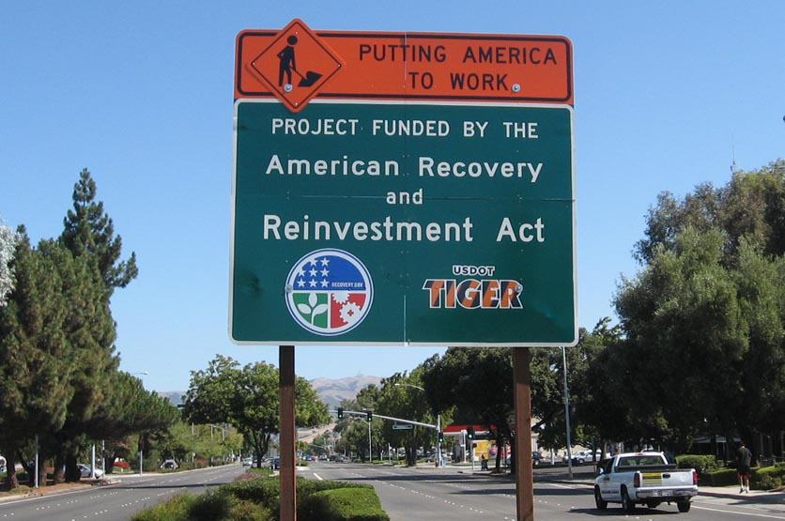
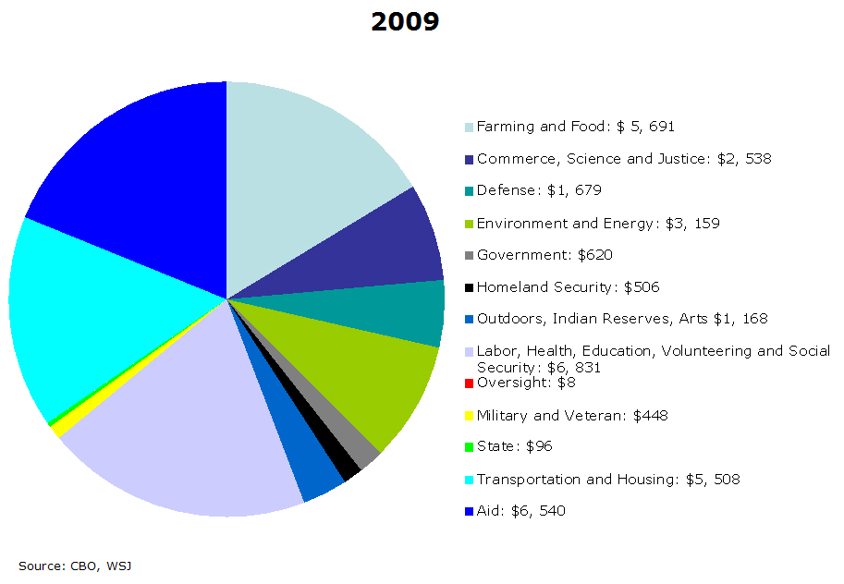

Slide 5
Ep. 8 – Fiscal Policy and Stimulus
Debate over fiscal policy: lack of government involvement → Great Depression issues → John Maynard Keynes (deficit spending) → crowding out (high interest rates)
Debate over 2009 Stimulus – argument that things would have been worse
European Austerity – raise taxes and reduce government spending to reduce debt
Stimulus is very hard to implement (not all are created equal)
Multiplier Effect → more spending

Slide 6
Ep. 9 – Deficits and Debts
Difference between DEFICIT and DEBT
National Debt = $24.7 trillion
Charts - Debt as a percentage of GDP and Debt to GDP ratios vs. other countries
“Our GDP grows every year, due to population growth and productivity increases. And our ability to sustain debt grows along with our income”

Slide 7
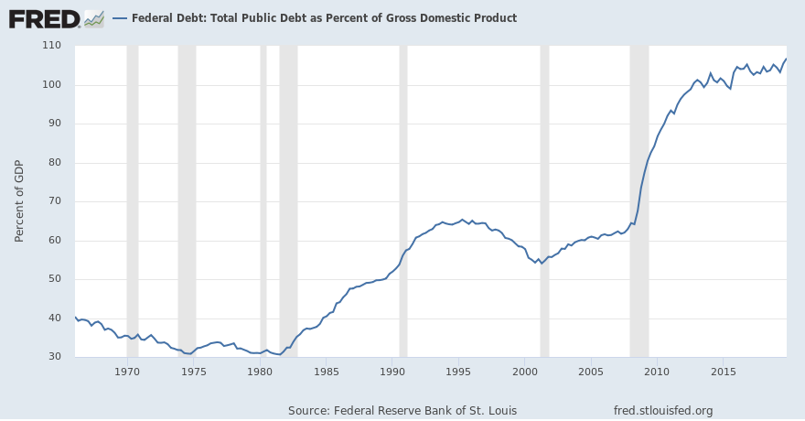
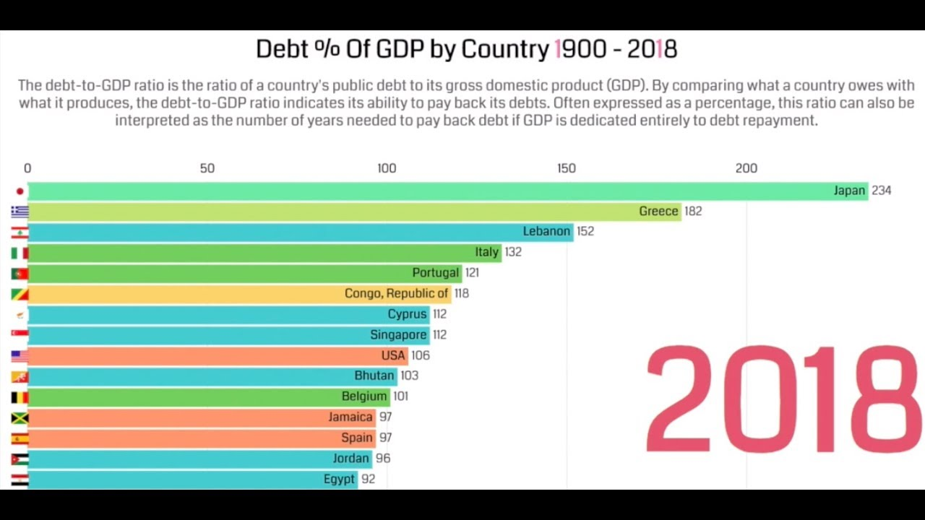

Slide 8
Ep. 9 – Deficits and Debts
Biggest recipients of federal dollars – elderly population
Social Security and Medicare
Defense projected to decrease as % of GDP (at time of recording)
Borrowing needs lenders – concern over fewer loans available
Greece – austerity programs, fears over loans not being paid, high interest rates

Slide 9
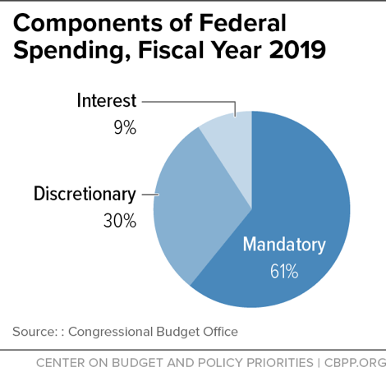
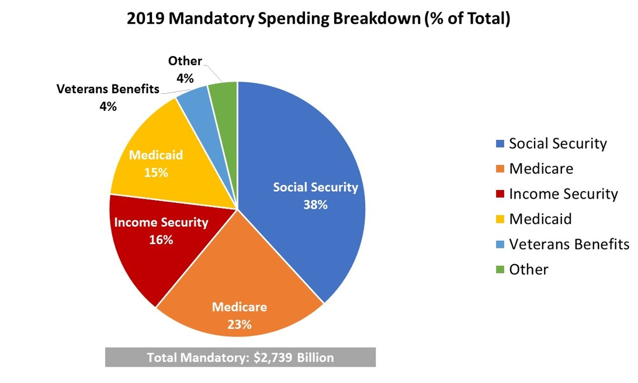
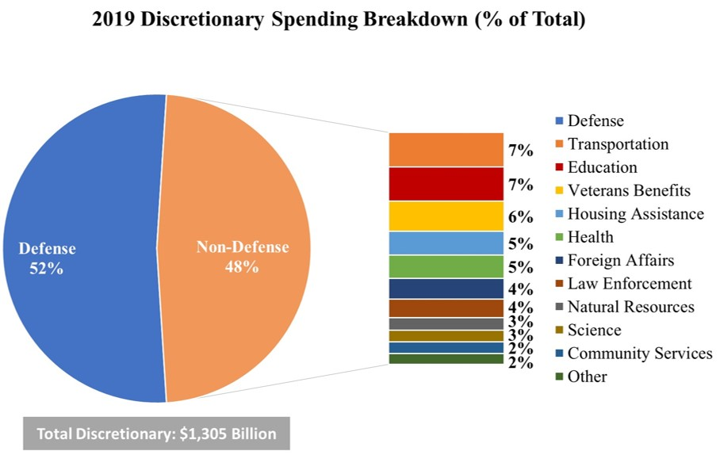

Slide 10
Ep. 9 – Deficits and Debts
U.S. has the debt ceiling (doesn’t cut spending or raise revenue, allows certain amount of borrowing and obligation to pay back loans)
Interest rates for government are low
Confidence in ability to repay
Growth in health care costs could be slowing down → health care spending is driving debt higher (could fall with worldwide pandemic?)

Slide 11
Ep. 10 – What’s All the Yellen About? Monetary Policy and the Federal Reserve
Federal Reserve (the Fed) – Central Bank of the U.S.
Regulates and oversees commercial banks so they have enough reserve
Conduct monetary policy (raising/lowering the money supply)
Number of car, school, business, home loans depends on interest rate
The Fed manipulates money supply to affect interest rates
CONTRACTIONARY: Less money = higher interest rates (slows economy)
EXPANSIONARY: more money = lower interest rates (speeds up economy)

Slide 12
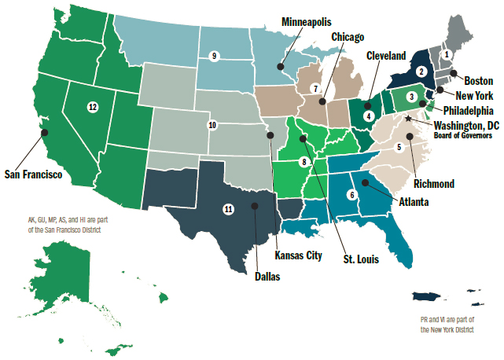

Slide 13
Ep. 10 – What’s All the Yellen About? Monetary Policy and the Federal Reserve
Banking system kept healthy by confidence and liquidity
Great Depression failure – banks allowed to fail early on, Fed didn’t given emergency loans to boost liquidity and money supply
Fractional Reserve Banking: bank holds part of deposit/loans out rest
Reserve Requirement: deposits required to be held in reserve by banks
How does a central change the money supply?
Change reserve requirements
Change the interest rate charged to banks
Open Market Operations (Fed buys/sells short terms government bonds)

Slide 14
Ep. 10 – What’s All the Yellen About? Monetary Policy and the Federal Reserve
Severity of the slump determines the use of Fiscal or Monetary Policy
Fiscal Policy: changing government spending or taxes
Monetary Policy: changing the money supply

Slide 15
Questions to Consider
Prepare thoughts on these questions for the video class meeting on Friday
How do you think the national debt affects you?
What could be done in the current crisis in the area of fiscal policy to help?
What could be done in the current crisis in the are of monetary policy to help?

